Slide 1
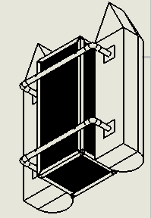
THE DESIGN OF A DEBRIS CLEARING VESSEL
Presented By:
Mohsin Mehmood
& Hafeez Shittu

Slide 2
Abstract:
The principle objective of this project is to design an autonomous marine vessel, use machine learning and target recognition to collect floating plastic bottles in a pond, lake and streams. The motivation behind this project is to find a cheaper and efficient solution for clearing certain water bodies (lakes, ponds, streams). By utilizing autonomous control, the vessel can operate freely and through machine learning, it can target plastic bottles and collect it. The mechanical design stages of any floating body consists of “Imagining and analyzing”, “Concept Design”, “Principle Design and GA drawings”, “CAD design and analysis”. The electrical design stages for components and control system consists of “…….Temmi……” Most of the time in each task will be spend on research. Mechanical design will require the weight calculations, Hydrostatics study, Flow analysis, FEM analysis using a CAD software (Solid Works). This will further help improve our design. The goal for Mechanical design is to ensure the body will float and will be stable under applied force. “Temmi”

Slide 3
Outline
Back ground
Project Objective
Design Requirements
Design Constraints
Design Approach
Tasks
Design research
Identifying a design
Mass Calculations
Hydrostatic study
Drag and lift
Electric components layout
Conclusion

Slide 4
Background
Motivation
Plastics and its harmful effects.
Innovating Existing products.

Slide 5
Project Objective
The objective of this project is to design a Catamaran(Dual Hull) marine vessel capable of detecting 500 ml plastic bottles within 1 meter radius and collect them using machine learning.

Slide 6
Design Requirements
The main frame of the vehicle should be able to support up to 60 lbs. of total load, including the Payload up to 20 lbs. and 25 lbs. of vehicle itself.
The motors should drive the vehicle with the velocity of 5 miles per hour.
The Design must be cost efficient.
Recognize floating plastic bottles using machine learning.
Should recognize the target (Volume 500ml, height 23.50cm, diameter 6.58, max weight .54kg and function intelligently.

Slide 7
Design Constraints
The main frame of the boat should be within 4ft * 3ft * 2ft (L*W*H).
Due to lack of funding, the overall budget for the mechanical design should be under 100$.
Limited Resources.
Easy to assemble.

Slide 8
Tasks
Task 1: Research Various Boat designs
Task 2: Preliminary boat design
Task 3: Weight Calculations
Task 4: Hydrostatic evaluation
Task 5: Fluid dynamics evaluation
Task 6: CAD simulations
Task 7: Building the prototype

Slide 9
Design Approach
Research Various Boat designs
Preliminary Boat designs
Weight Calculations
Hydrostatic study
Fluid Dynamics Calculations
CAD Simulation
Flow Analysis
FEM Analysis
Building a Prototype.
Research Various Boat designs
Preliminary Boat designs
Weight Calculations
Hydrostatic study
Fluid dynamics calculations
CAD Simulation
Flow analysis
FEM analysis
Building a Prototype

Slide 10
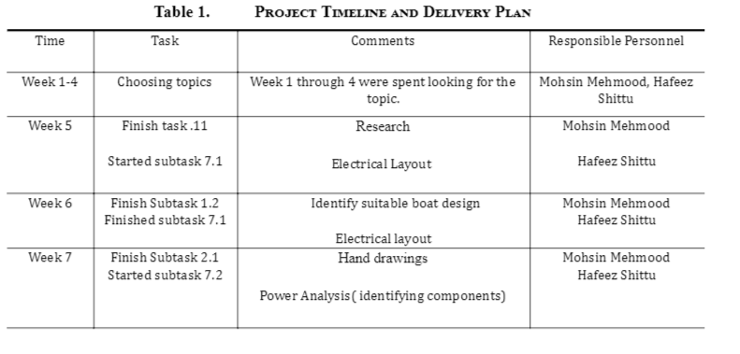
Project Timeline

Slide 11
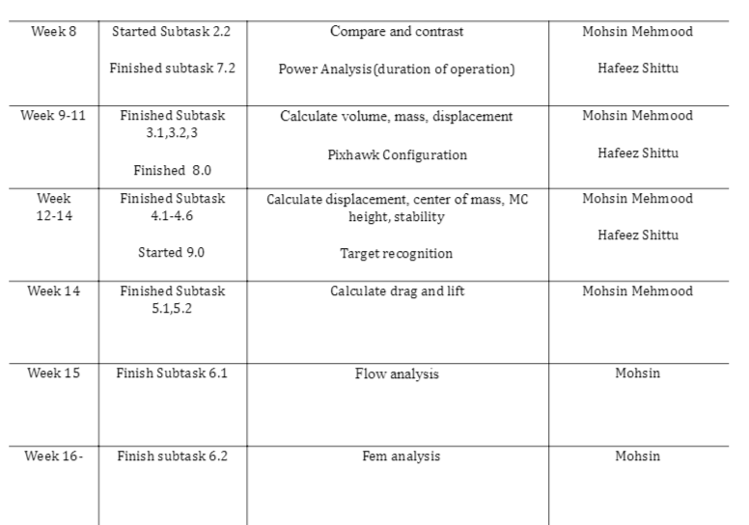
Project Timeline (Continued)

Slide 12
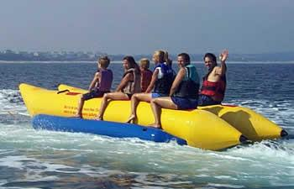
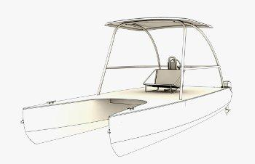
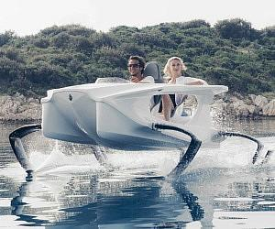
Implementation:
Research
Banana Boats
Hydrofoil boats
Catamaran Boats
Pontoons and its advantages:
Ease of Use/Maintenance
Building Cost and Storage
Longevity

Slide 13
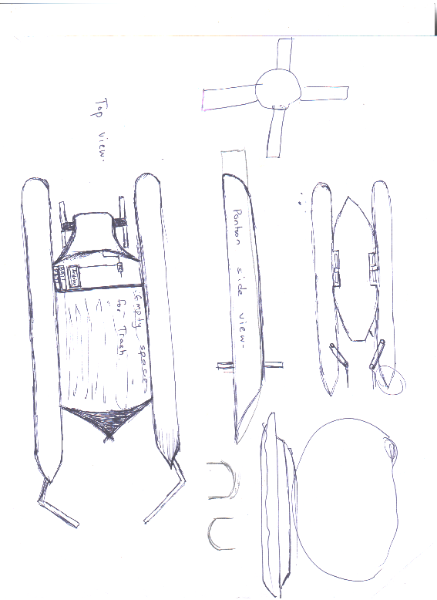
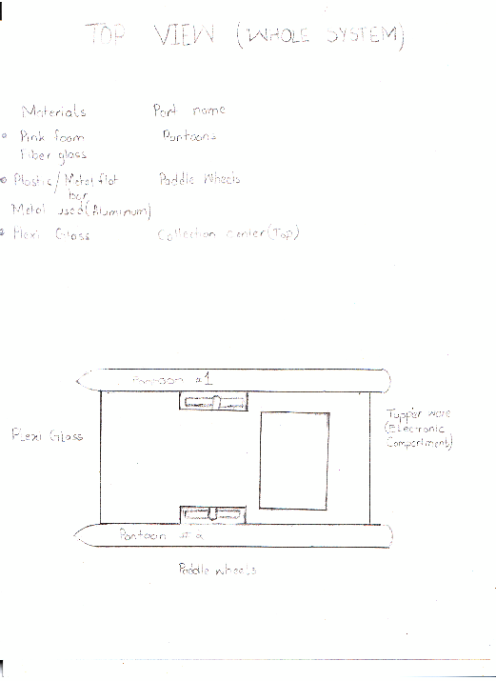
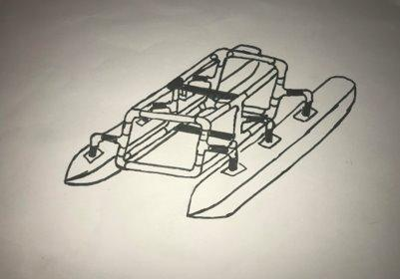
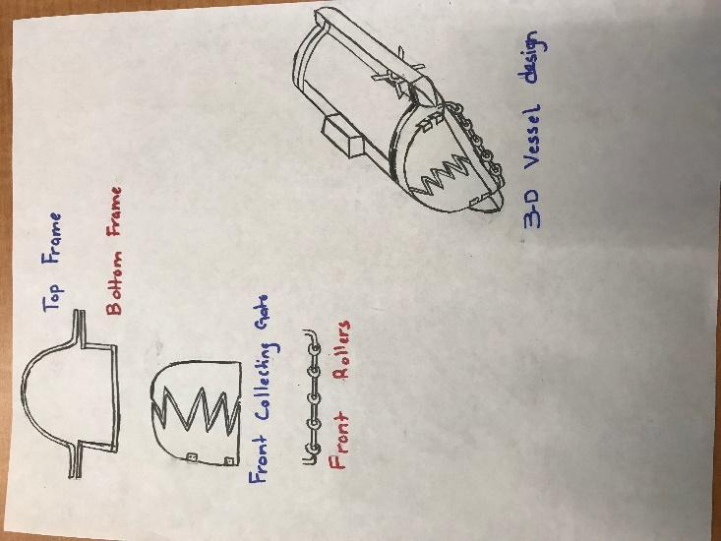
Implementation of Task 2.
Earlier designs:
Pros:
The frame is very light.
The pontoons are also very light.
This is cost-efficient.
The parts can be re-assembled for storage.
Malleable parts.
Cons:
Lack of storage
Shallow ends collection

Slide 14
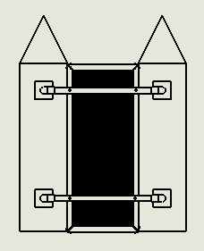
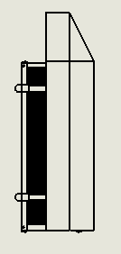
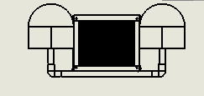
Final design
The 2-D drawings for the final design are as following

Slide 15
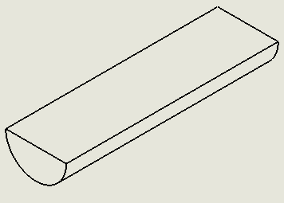
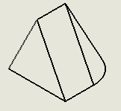
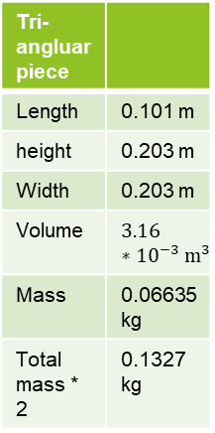
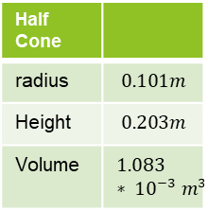
Implementation of Task 3 .
Weight Calculations:
Half Cylinder
radius | 0.1060
Density | 21 kg/m^3
Height | 0.7154 m
Volume | 0.011 m^3
Mass | .24213 kg
Mass * 2 | .48426 kg
Half Cone
radius | $$0.101m$$
Height | $$0.203m$$
Volume | $$1.083 ∗ {10}^{−3} m^{3}$$
Tri-angluar piece
Length | 0.101 m
height | 0.203 m
Width | 0.203 m
Volume | $$3.16 ∗{10}^{−3} m^{3}$$
Mass | 0.06635 kg
Total mass * 2 | 0.1327 kg

Slide 16
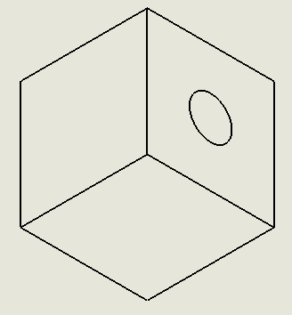
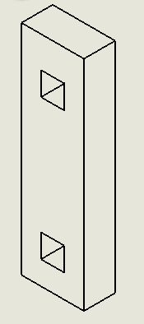
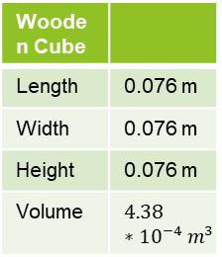
Continued
Wooden Cube
Length | 0.076 m
Width | 0.076 m
Height | 0.076 m
Volume | $$4.38 ∗{10}^{−4} m^{3}$$
Outside rectangle
Length | 0.711 m
Width | 0.203 m
Height | 0.101 m
Volume | 0.0145 m^3
Inner circle
Height | 0.025 m
Radius | 0.0125 m
Volume | 0.000678 m^3
Over all Mass | 0.23052 kg
Mass *4 | 0.092208 kg
Total volume
Volume | 0.0272 m^3
Mass | 0.2856 kg
Mass *2 | 0.5712 kg

Slide 17
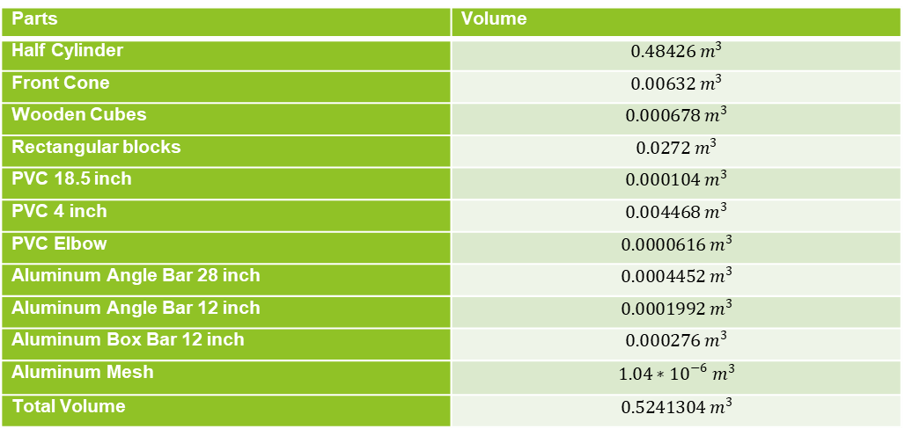
Total Volume table
Parts | Volume
Half Cylinder | $$0.48426 m^{3}$$
Front Cone | $$0.00632 m^{3}$$
Wooden Cubes | $$0.000678 m^{3}$$
Rectangular blocks | $$0.0272 m^{3}$$
PVC 18.5 inch | $$0.000104 m^{3}$$
PVC 4 inch | $$0.004468 m^{3}$$
PVC Elbow | $$0.0000616 m^{3}$$
Aluminum Angle Bar 28 inch | $$0.0004452 m^{3}$$
Aluminum Angle Bar 12 inch | $$0.0001992 m^{3}$$
Aluminum Box Bar 12 inch | $$0.000276 m^{3}$$
Aluminum Mesh | $$1.04∗{10}^{−6} m^{3}$$
Total Volume | $$0.5241304 m^{3}$$

Slide 18
Total Mass table
Parts | Mass
Half Cylinder | 0.48426 kg
Front Cone | 0.13272 kg
Wooden Cubes | 0.92208 kg
Rectangular blocks | 0.5712 kg
PVC 18.5 inch | 0.1352 kg
PVC 4 inch | 0.058 kg
PVC Elbow | 0.08008 kg
Aluminum Angle Bar 28 inch | 0.120204 kg
Aluminum Angle Bar 12 inch | 0.538 kg
Aluminum Box Bar 12 inch | 0.752 kg
Aluminum Mesh | 2.85 kg
Screws | 0.117 kg
Total Mass | 6.760744 kg

Slide 19
Ship weight
Three types of different weights need to be known and are as following:
Light weight:
This is the weight of the unrigged vessel without gear, fuel oil, water, ice, boxes, crew, provisions, catch, etc.
Dead Weight:
All unnecessary weight and payload weight.
Displacement:
Displacement is the term for the vessel’s total weight. That means displacement = lightweight + deadweight.

Slide 20
Implementation of task 4 >>Mass breakdown
Total weight of the building materials = 6.760744 kg =>14.8736368 pounds
The mass of electronics = 10.17 pounds
Maximum Mass of the payload = 25 pounds
Total weight of the boat including dead weight and payload weight = 50 pounds => 22.72727 kg

Slide 21
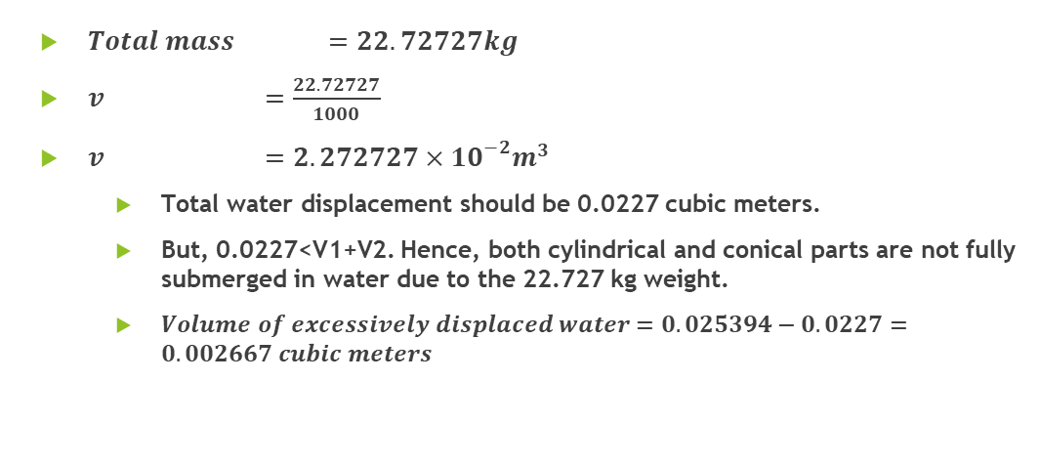
Total Water Displacement
$Total mass =22.72727kg$
$v =\frac{22.72727}{1000}$
$v =2.272727×{10}^{−2}m^{3}$
Total water displacement should be 0.0227 cubic meters.
But, 0.0227<V1+V2. Hence, both cylindrical and conical parts are not fully submerged in water due to the 22.727 kg weight.
$Volume of excessively displaced water=0.025394−0.0227=0.002667 cubic meters$

Slide 22
Height of the boat submerged in water
If height of excessively displaced water is h,

Slide 23
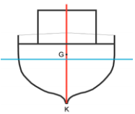
Centre of gravity G
The centre of gravity is a rather theoretical concept. It is composed of all weights on board, including the vessel’s own weight (lightweight).

Slide 24
Center of mass (continued)
Since the density of the Styrofoam is extremely low whereas the volume of the PVC parts is negligible, one can assume that the center of mass of the boat is the one of the container.
The distance between the center of mass of semicircle and the center of mass of the respective circle is the following:
.
One can calculate the x and z coordinates of the center of mass of the cone part as follows
Where,
.

Slide 25
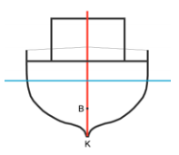
Centre of buoyancy B
Weight under water affects the overall buoyancy.
buoyant force can be merged in one single point called the centre of buoyancy and this is indicated by the letter B.
B is not fixed; it changes all the time depending on the vessel’s draft, heel and trim.

Slide 26
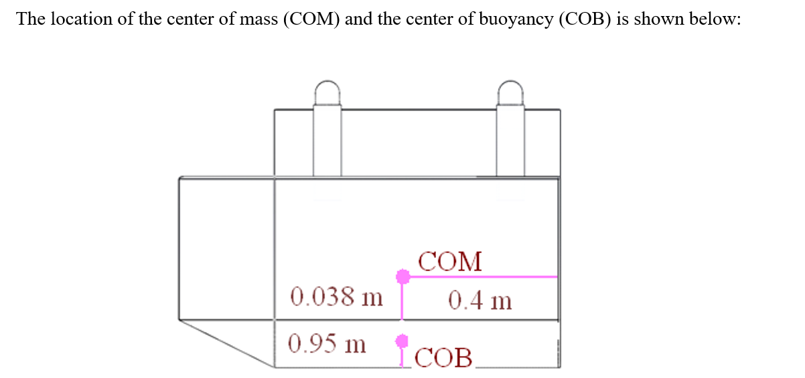
Center of buoyancy (continued)
Part | , cubic meters | , meters | , meters | , meters
Left semi-cone | 0.000931 | -0.1396 | 0.4295 | -0.0389
Right semi-cone | 0.000931 | 0.1396 | 0.4295 | -0.0389
Left semi-cylinder | 0.01043 | -0.1396 | 0 | -0.0475
Right semi-cylinder | 0.01043 | 0.1396 | 0 | -0.0475
Center of the buoyancy |  | 0 | 0.035203 | -0.0468

Slide 27
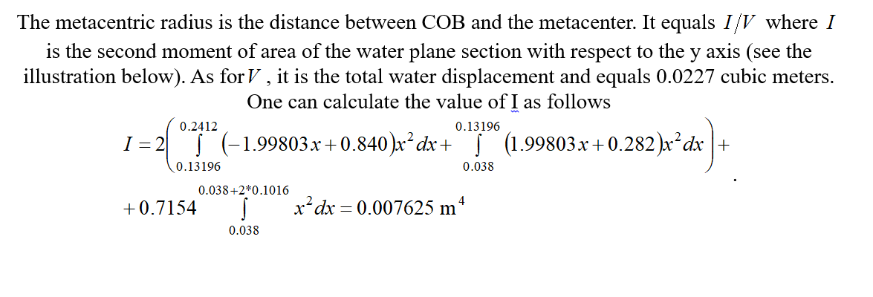
Metacentric radius

Slide 28
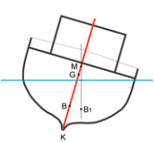
Metacentric height GM
Under a light small heeling, the vertical line of buoyancy intersects with the vessel’s centre line at a point called meta centre.
The distance between the centre of gravity G and meta centre M is called the metacentric height GM.

Slide 29
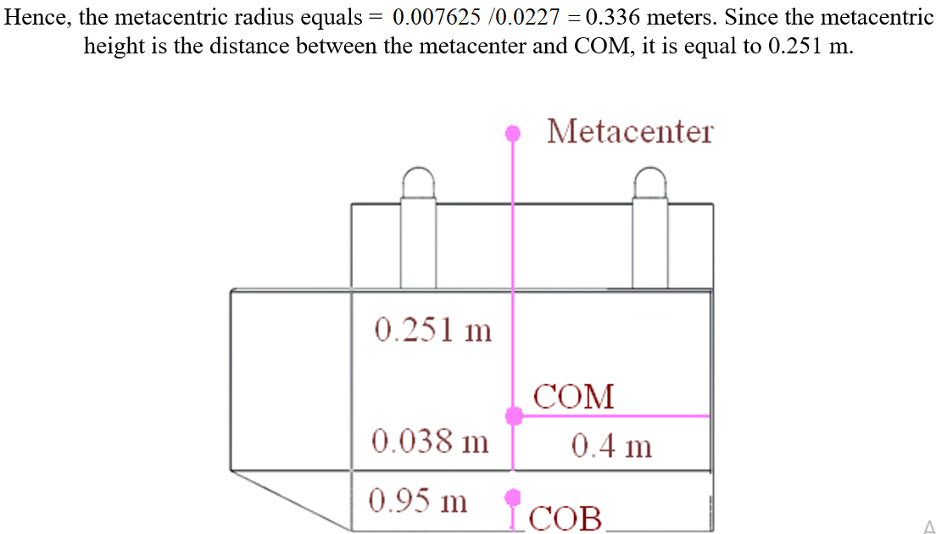
Metacentric height

Slide 30
Ship Stability
Stability is a measure of the vessel’s ability to get back on an even keel after having suffered a heel.
The vessel’s own weight and the distribution of the weights on the vessel are essential for determining the vessel’s stability

Slide 31
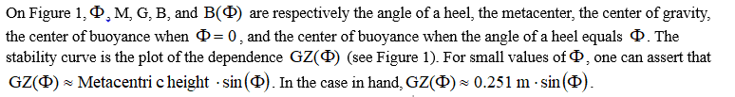
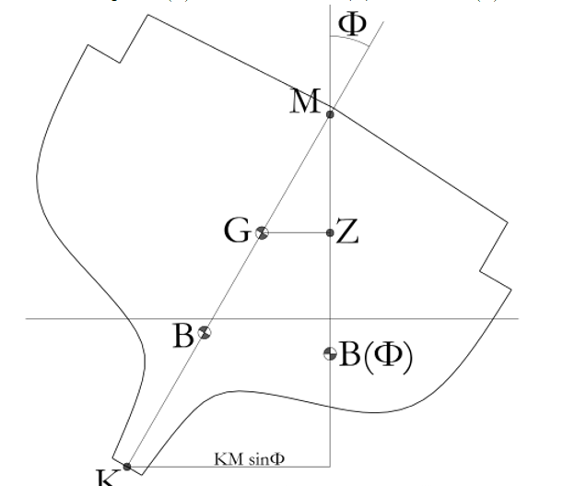
Stability of the boat (Continued)

Slide 32
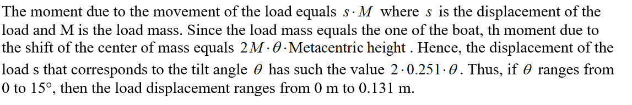
Stability based on 0-15 degrees tilt

Slide 33
Implementation of Task 5
To finding out the Drag and Lift forces that will be applied to the design while moving at the velocity of 5mph.
This will compute the fluid dynamics of the design.

Slide 34
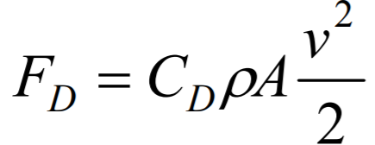
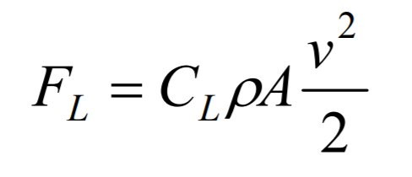
Drag and lift forces
The drag force acts in a direction that is opposite of the relative flow velocity. – Affected by cross-section area (form drag) – Affected by surface smoothness (surface drag)
The lift force acts in a direction that is perpendicular to the relative flow. – The lift force is not necessarily vertical.

Slide 35
Drag and lift (continued)
Drag force for the system:

Slide 36
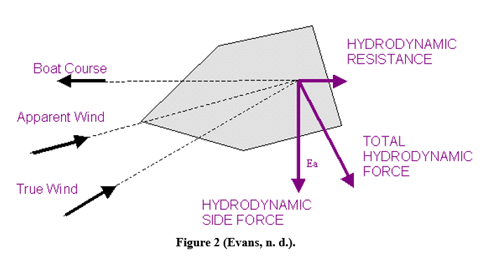
Drag and lift (continued)
Lift force for the system:

